Slide 1


Synopsis Presentation on Campus Connect: Bridging Opportunities
Guided By: Presented By:
Prof. Prashant Lakkadwala Jahnavi Mandloi
Jayshree Dave
Mahee Dubey
Minakshi Soni

Slide 2
Contents
Introduction
1.1 Overview
1.2 Purpose
Literature Review
Problem Statement
Proposed Solution
Objectives
Theoretical Analysis
6.1 Block Diagram
6.2 Hardware Requirements
6.3 Software Requirements
Applications
REFERENCES

Slide 3
1. Introduction
1.1 Overview
Bridging Opportunities is a comprehensive platform designed to streamline the recruitment process for colleges, students, and companies.
It enables seamless communication between students, the college administration (admin), and recruiters, ensuring efficient hiring and placement processes.
The system allows companies to request recruitment drives, which must be approved by the admin before students can access them.
Eligible students are notified, and they can track their applications, view recruitment statuses, and receive updates on selections.

Slide 4
1.2 Purpose
The primary goal of Campus Connect is to simplify and automate the recruitment process for colleges and students while providing companies with an efficient platform to find suitable candidates.
With features like recruitment notifications, student eligibility tracking, and selection management, the system enhances transparency and improves hiring efficiency.
Provide a centralized platform for accessing job opportunities, submitting applications, and tracking recruitment statuses.
Offer an easy way to engage with college students, post job openings, and streamline the selection process.

Slide 5
2. Literature Review
Sr. No. | Name of Solution/System | Features | Limitations/ Drawbacks
1 | Manual Campus Recruitment | Email-based, physical meetings, notice boards | Time-consuming, inefficient, lack of transparency
2 | Naukri.com | Job listings and applications | Limited access to student data, not campus-specific
3 | LinkedIn | Networking platform for professionals | Not designed for campus recruitment, difficult filtering
4 | Campus Connect | Automated recruitment, real-time tracking, centralized communication | Requires internet, initial setup/training needed

Slide 6
3. Problem Statement
Manual and Disjointed Processes: Recruitment drives are organized through physical meetings, emails, and manual paperwork, leading to significant delays and errors in communication.
Lack of Transparency: Students face difficulties in tracking the status of their applications, eligibility criteria, and recruitment results. They are often unaware of important updates or miss out on opportunities due to poor communication.
Administrative Challenges: College admins struggle to manage multiple recruitment drives, track applications, and maintain up-to-date records of student profiles and recruitment statuses. This results in time-consuming processes and administrative overload.
Limited Reach for Companies: Companies find it challenging to directly access the right candidates due to limited data visibility on student qualifications, skills, and eligibility. As a result, companies may miss out on qualified candidates.

Slide 7
4. Proposed Solution
Automated Recruitment Process: Companies can initiate drives, which are approved by admins. Eligible students are automatically notified, reducing manual effort and delays.
Centralized Communication: A single platform for students, companies, and colleges to interact, ensuring clear and timely updates on applications and selections.
Real-Time Tracking: Students can track their application statuses and receive updates on interviews and selections, while companies can monitor candidate progress.
Transparent Eligibility & Selection: Students can check eligibility before applying, and companies can access detailed student profiles to ensure a better match for recruitment.

Slide 8
5. Objectives
Streamline Recruitment Processes: Automate and simplify the recruitment process for colleges, students, and companies, reducing manual effort and delays.
Enhance Communication: Provide a centralized platform for clear, timely communication between students, colleges, and recruiters.
Improve Transparency: Ensure students are informed of eligibility criteria, application status, and selection results in real-time.
Facilitate Easy Access to Data: Allow companies to easily access student profiles, track applications, and make better hiring decisions
Enable Efficient Management for Admins: Simplify the process of managing student records, recruitment drives, and application tracking for college admins..
Increase Recruitment Efficiency: Help companies reach qualified candidates faster by providing a targeted, transparent, and organized recruitment process.

Slide 9
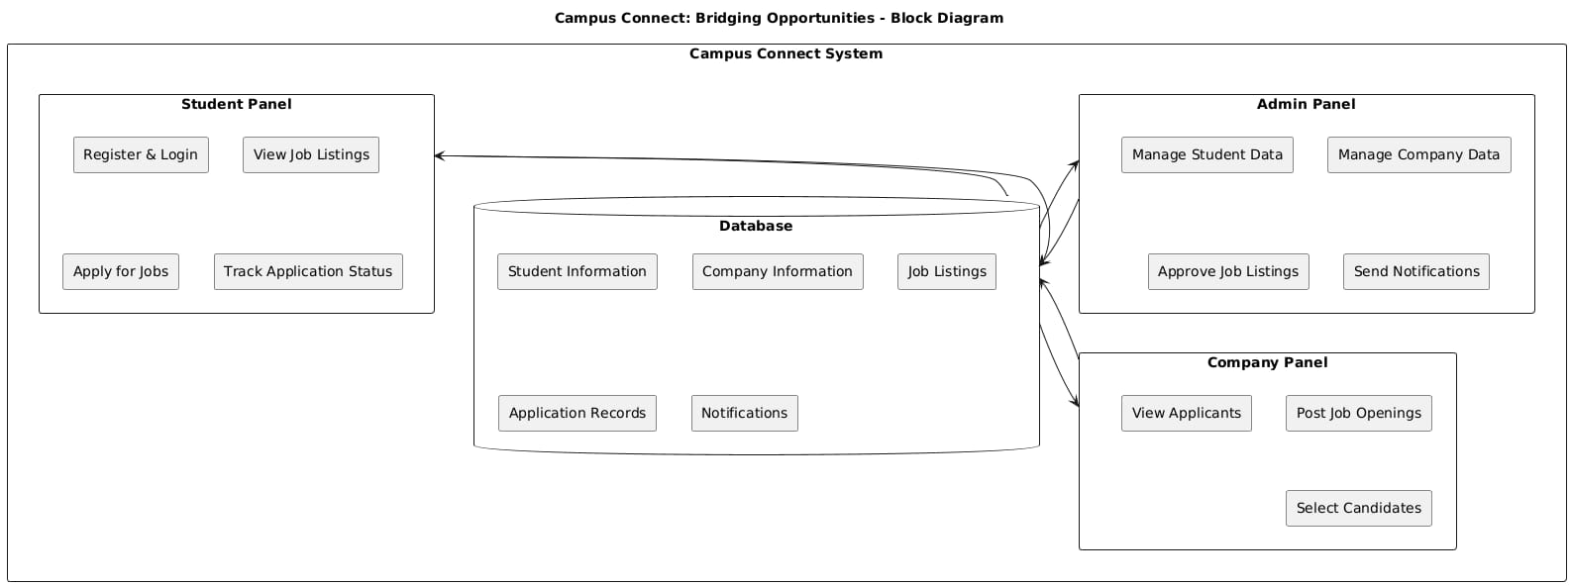
6. Theoretical Analysis
6.1The system architecture includes three main entities: Admin, Students, and Companies.

Slide 10
6. Theoretical Analysis
6.2 Hardware Requirements
Processor: Intel Core i5 or higher
RAM: 8 GB or more
Storage: Minimum 100 GB free space for storing application data, logs, and user information
6.3 Software Requirements
Programming Languages: Java, HTML, CSS, JavaScript
Database: MySQL
Frameworks: Servlet, JDBC
IDE: NetBeans

Slide 11
Applications
Colleges: Manage recruitment drives and student data efficiently.
Students: Apply to multiple jobs ,track application statuses and get real-time notifications.
Companies: Access student profiles, track applications, and streamline the recruitment process.
Admins: Oversee recruitment processes, manage student records, and ensure smooth operations.
Increased Efficiency: Automates manual tasks, reducing administrative workload for colleges.
Better Candidate Matching: Companies can filter candidates based on specific criteria for accurate selections.

Slide 12
GitHub Link
Jahnavi Mandloi(0827IT211048) https://github.com/jahnavimandloi50
Jayshree Dave(0827IT211050)
https://github.com/Jayshreedave17
Mahee Dubey (0827IT211065)
https://github.com/mahidubey2003
Minakshi Soni(0827IT211069)
https://github.com/Minakshi-26

Slide 13
REFERENCES
[1] I.A. Glover and P.M. Grant, Digital Communications, 3rd ed. Harlow: Prentice Hall, 2009.
[2] F. Yan, Y. Gu, Y. Wang, et al., 'Study on the interaction mechanism between laser and rock during perforation,' Optics and Laser Technology, vol. 54, pp. 303-308, Dec 2013.
[3] BBC News. (2013, Nov. 11). Microwave signals turned into electrical power [Online]. Available: http://www.bbc.co.uk/news/technology-24897584.

Slide 14
Thank You
Queries ?

